Slide 1
Updates on Experiments

Slide 2
New Architecture Experiments
Experiments till now:
Originally proposed network is very deep, every batch (of size 8) and requires huge memory to compute. So, had to switch to a much shallower network(which isn’t advised in SR models). (Only 2 ResGroups & 4 ResBlocks)
Tried experimenting with loss function coefficients and the learning rates of discriminator and generator both, so as to achieve faster convergence.
Also tried varying the size of larger kernel, however, use of different sized kernels did not seem to help resolve the images better.
Tried replacing Channel Attention layers with Transformer Layers to see how it behaves, however couldn’t draw any concrete results due to incomplete training.

Slide 3
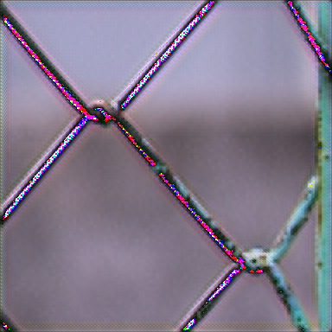

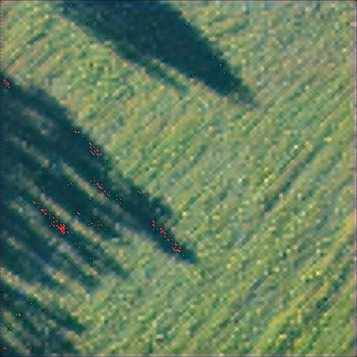
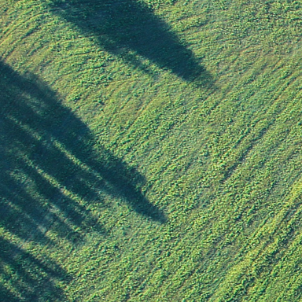
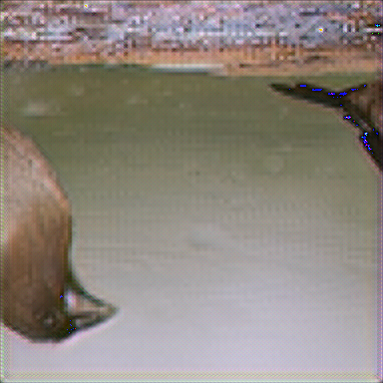
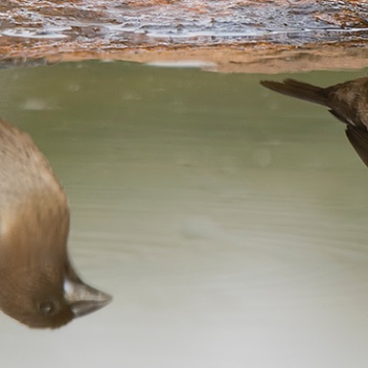
Some Qualitative results
SR Image
HR Image
SR Image
HR Image
SR Image
HR Image

Slide 4
Training ESRGAN with NIQE Loss Function
[ INFO ] Use GPU: 0 for training.
[ INFO ] Using pre-trained model `esrgan16`.
[ INFO ] Losses function information:
Pixel: L1Loss
Content: VGG19_35th
Niqe: Niqe
Adversarial: BCEWithLogitsLoss
[ INFO ] Optimizer information:
PSNR learning rate: 0.0002
Discriminator learning rate: 0.0001
Generator learning rate: 0.0001
PSNR optimizer: Adam, [betas=(0.9,0.999)]
Discriminator optimizer: Adam, [betas=(0.9,0.999)]
Generator optimizer: Adam, [betas=(0.9,0.999)]
PSNR scheduler: CosineAnnealingWarmRestarts, [T_0=psnr_epoch_indices, T_mult=1, eta_min=1e-7]
Discriminator scheduler: MultiStepLR, [milestones=epoch_indices, gamma=0.5]
Generator scheduler: MultiStepLR, [milestones=epoch_indices, gamma=0.5]
[ INFO ] Load training dataset
[ INFO ] Dataset information:
Train Path: /content/drive/MyDrive/Super Resolution Project Sem 2 (20-21)/ESRGAN-PyTorch//content/drive/MyDrive/Super Resolution Project Sem 2 (20-21)/Datasets/benchmark/Flickr2K/train
Test Path: /content/drive/MyDrive/Super Resolution Project Sem 2 (20-21)/ESRGAN-PyTorch//content/drive/MyDrive/Super Resolution Project Sem 2 (20-21)/Datasets/benchmark/Flickr2K/test
Number of train samples: 2256
Number of test samples: 2256
Number of train batches: 141
Number of test batches: 141
Shuffle of train: True
Shuffle of test: False
Sampler of train: False
Sampler of test: None
Workers of train: 4
Workers of test: 4

Slide 5
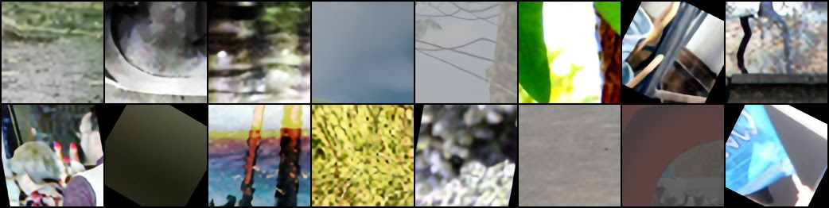
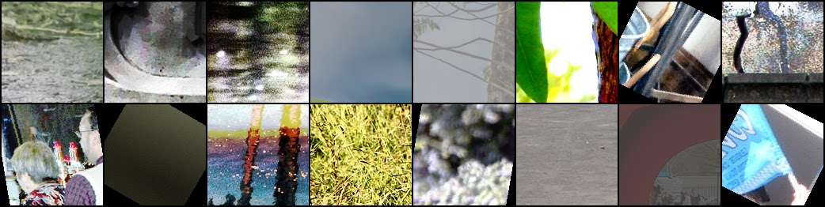
SR Images
HR Images

Slide 6
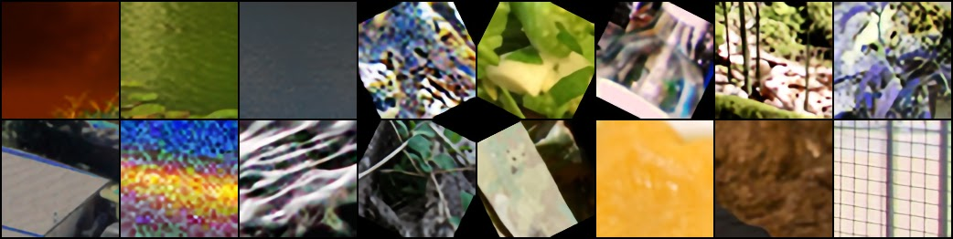

SR Images
HR Images

Slide 7
Endsem Presentation

Slide 8
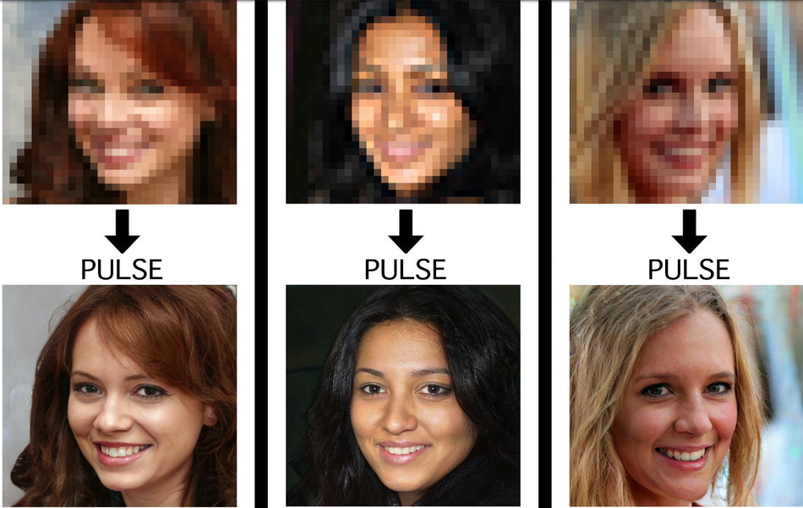
Image Super Resolution Task
Input : Low Resolution Image
Output: High Resolution Image

Slide 9
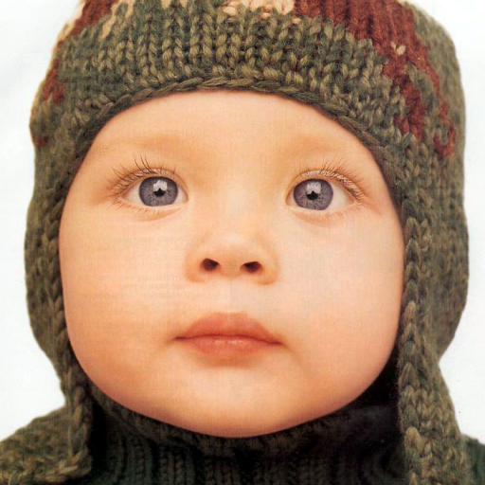
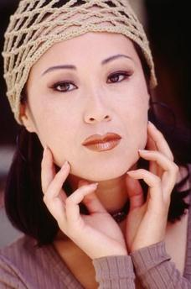
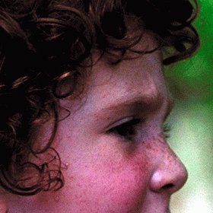
Datasets
Models are generally trained on DIV2k dataset consisting of 1000 2K resolution high quality images, generally split as 800(training) + 100(validation) + 100(testing)
And compared by testing on Set5, Set14, BSD100, Urban100 datasets.

Slide 10
Models reviewed
 | EDSR | RCAN | SRGAN | ESRGAN
Model | Used ResNets without BN to get SR image of same distribution as input. | Used channel attention to learn inter-channel feature dependencies | GAN based approach with Standard Discriminator | Uses RRDB as basic units and relativistic discriminator
Batch Normalization | No | No | Yes | No
Loss Function | L1 Loss function | L1 Loss function | Perceptual Loss for generator, Min Max Loss for discriminator | Perceptual Loss (before activation layers)
Author’s results on Set5 dataset | PSNR: 32.46 SSIM: 0.8968 | PSNR: 32.73 SSIM: 0.9013 | PSNR: 29.40 SSIM: 0.84 | PSNR: 32.73 SSIM: 0.9011

Slide 11
Architecture Hyperparameters
Hyper Param | EDSR | RCAN | SRGAN | ESRGAN
Training Dataset | DIV2K | DIV2K | ImageNet | DIV2K
Data Augmentation | Flip & rotation (x8) [done in EDSR+] | Flip & rotation (x8) [done in RCAN+] | - | Flip & rotation
Mini batch size | 16 | 16 | 16 | 16
Depth | 32 ResBlocks | 10 RGs (20 RCABs in each) | 16 ResBlocks | 23
Upscaling Factor | 2x/3x/4x/8x | 2x/3x/4x/8x | 4x | 4x

Slide 12

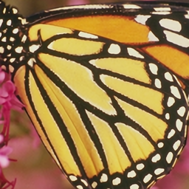

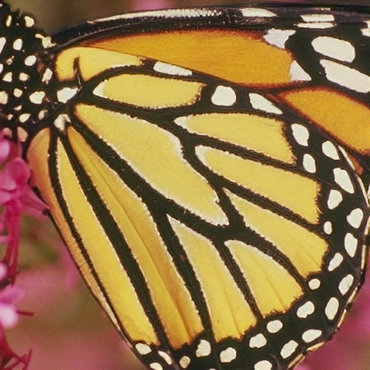
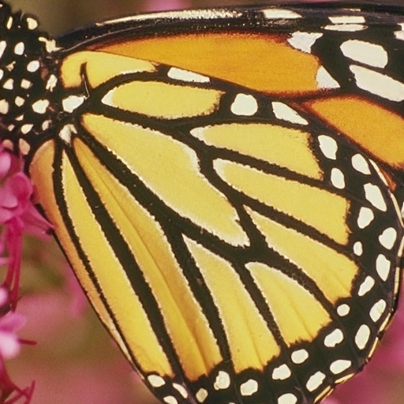

Qualitative Results
LR Input Image
EDSR
RCAN
SRGAN
ESRGAN
HR Ground Truth

Slide 13



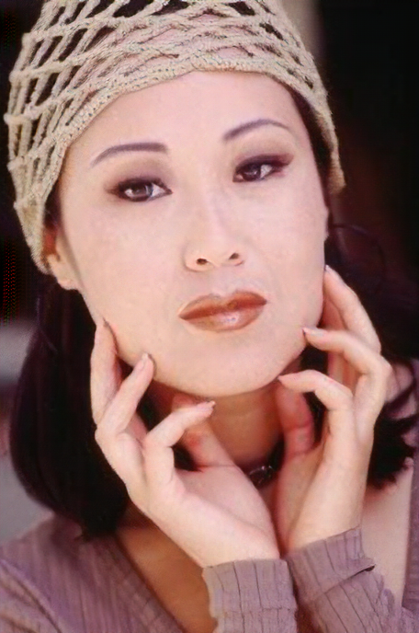

Low Resolution
Input Image
EDSR
RCAN
SRGAN
High Resolution
Ground Truth
ESRGAN

Slide 14
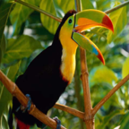
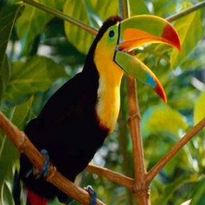

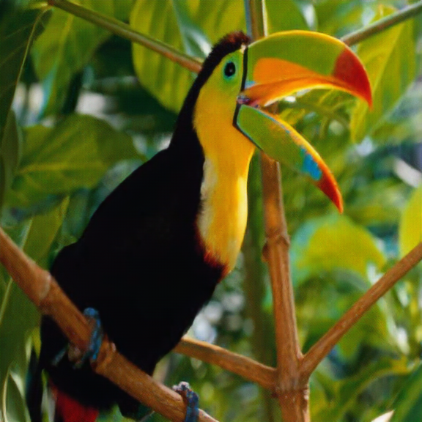


Low Resolution
Input Image
EDSR
RCAN
SRGAN
High Resolution
Ground Truth
ESRGAN

Slide 15
Quantitative Results (4x upscaling)
Model Name | PSNR (Ours) | PSNR (Author) | SSIM (Ours) | SSIM (Author)
EDSR | 32.095 | 32.46 | 0.892 | 0.8968
RCAN+ | 32.738152 | 32.73 | 0.900286 | 0.9013
SRGAN | 29.373820 | 29.40 | 0.841682 | 0.8472
ESRGAN | 32.730021 | 32.73 | 0.901131 | 0.9011

Slide 16
Conclusion from comparative study
While SRGAN argues that batch normalization leads to faster convergence, ESDR argues that BN leads to inflexibility in the output range with more parameters to learn and ESRGAN avoids BN due to artifacts in the output images. Thus, we may conclude removing batch normalisation in SR tasks resolves artifacts and makes the model simpler.
From all the models, we have concluded that using residual connections have outperformed the benchmarks. So it is a good idea to keep residual/dense nets in an SR architecture along with short and long skip connections.
It has been suggested that deeper networks perform better than wider ones (for Super Resolution), so residual nets would help train better.
Using a combination of PSNR oriented loss function like L1 loss and perceptual loss helps in optimising both PSNR & perceptual quality of the SR image.

Slide 17
IQA Metrics
Full Reference Metrics
Full-reference algorithms compare the input image against a pristine reference image with no distortion.
PSNR, SSIM, IFC, VIF
No reference Metrics
No-reference algorithms use statistical features of the input image to evaluate the image quality.
NIQE, Perceptual Index
Notes:
https://in.mathworks.com/help/images/image-quality-metrics.html#:~:text=over%20the%20image.-,No%2DReference%20Quality%20Metrics,to%20evaluate%20the%20image%20quality.&text=A%20BRISQUE%20model%20is%20trained,the%20same%20type%20of%20distortion.

Slide 18
ANALYSIS OF IQA METRICS
 | VIF | GMSD | PIQE | NIQE | BRISQUE
EDSR | 0.516 | 0.050 | 77.066 | 5.793 | 42.2498
RCAN | 0.535 | 0.046 | 82.952 | 6.1899 | 43.181
SRGAN | 0.422 | 0.069 | 24.857 | 4.362 | 21.620
ESRGAN | 0.45 | 0.061 | 35.938 | 4.362 | 25.828
HR | - | - | 41.049 | 4.850 | 34.079
Table: Numerical Values of IQA Metrics for different models
As seen from the results in table and comparing with corresponding qualitative results obtained, we can conclude that the no reference metrics are more suitable for evaluating images having better perceptual quality and feel more natural.

Slide 19
ANALYSIS OF SR LOSS FUNCTIONS
Loss Function | Conclusion
MSE Loss | Maximises PSNR however restricts models to pixel space only and results in low quality images.
L1 Loss | Results in good quality images while also restricting the model in pixel space thus maximising PSNR values. Since, our focus is on constraining to perceptual quality than pixel quality, we can use L1 only to instantiate our model in a 2 step training process or as a part of our loss function
VGG Loss | A good placeholder to capture the perceptual quality loss and used extensively in GANs. Constraints the model on feature space rather than pixel space
LPIPS Loss | A recently introduced perceptual loss function that minimises the LPIPS score for the images. Outperforms VGG Loss for extreme SR (16x or more upscaling)

Slide 20
Conclusion
Proposed to resolve the bandwidth limitations in video conferencing by providing super resolution of videos at the receiver’s end
Performed a detailed qualitative and quantitative analysis of different popular architectures in single image super resolution task namely EDSR, RCAN, SRGAN and ESRGAN
Concluded that GAN based approaches perform better than the DCNN based approaches.
Models without batch normalisation and with residual networks as part of their architectures give faster convergence and more accurate results with lesser architects.
Performed an analysis of different IQA metrics and concluded that the No-Reference IQAs seem to have a correlation with the human perception of good quality images.
Analysed different loss functions as used by many authors in the super resolution literature and concluded that a combination of pixel wise loss like PSNR oriented loss functions and perceptual loss functions result in both pixel wise similarity perceptually good images.

